Slide 1
Logistic regression from scratch in Python
Comparing the function for logistic regression from sk-learn
with our own function, written “from scratch”
Author: M. Kolaksazov
Source: Nick Becker, data scientist (https://beckernick.github.io/logistic-regression-from-scratch/)

Slide 2
Short summary, describing the problem
Task: write a piece of code, describing the logistic regression model for classification of categorical data
Logistic regression: a generalized linear model, used to predict categorical variables. In logistic regression, vector parameters, called weights must be found out, that maximize the likelihood of the given data.
Procedure:
First, the so-called link function is used to transform the variables of the data from the continuous scale to a categorical response (0 or 1 in the simplest case). After the transformation is complete, the relationship between the predictors and the response can be modeled with linear regression.
Next, the likelihood of the data must be maximized, which was done by the means of the log-likelihood function.
Afterwards, the gradient, as well as the gradient ascent must be calculated.
Finally, the function for the logistic regression can be implemented and the model can be calculated with an intercept

Slide 3
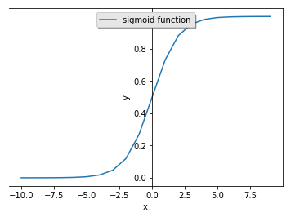
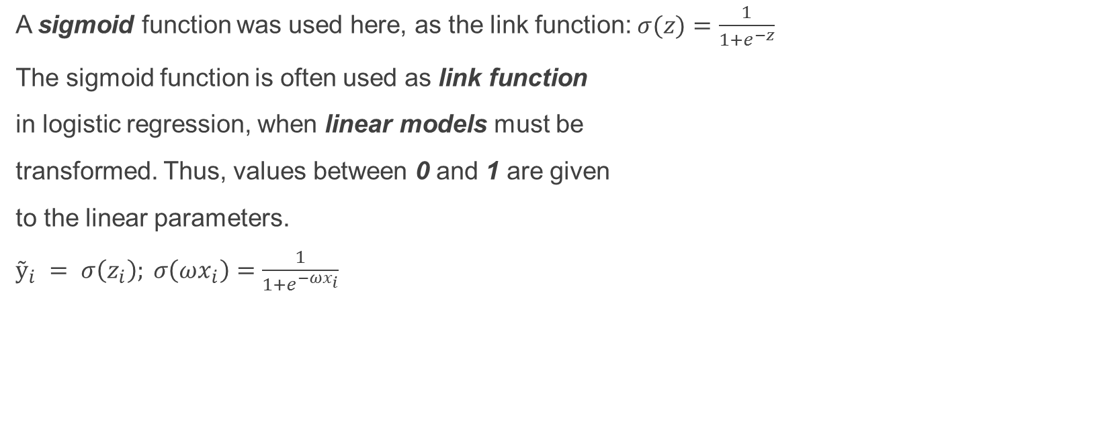
Transformation of input data by the means of the link function
A sigmoid function was used here, as the link function: $σ(z)=\frac{1}{1+e^{−z}}$
The sigmoid function is often used as link function
in logistic regression, when linear models must be
transformed. Thus, values between 0 and 1 are given
to the linear parameters.
$ỹ_{i} = σ\left(z_{i}\right); σ\left(ωx_{i}\right)=\frac{1}{1+e^{−ωx_{i}}}$

Slide 4
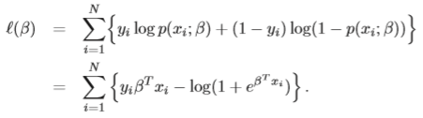
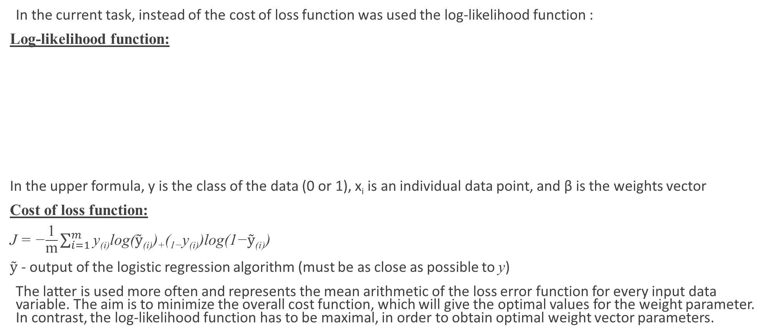
Log-likelihood function
In the current task, instead of the cost of loss function was used the log-likelihood function :
Log-likelihood function:
In the upper formula, y is the class of the data (0 or 1), x_{i} is an individual data point, and β is the weights vector
Cost of loss function:
J = −$\frac{\text{1}}{\text{m}}\sum_{i=1}^{m}{\text{y}\text{(}\text{i}\text{)}\text{log}\text{(}ỹ\text{(}\text{i}\text{))+(1−}\text{y}\text{(}\text{i}\text{))}\text{log}\text{(1−}ỹ\text{(}\text{i}\text{))}}$
$ỹ$ - output of the logistic regression algorithm (must be as close as possible to y)
The latter is used more often and represents the mean arithmetic of the loss error function for every input data variable. The aim is to minimize the overall cost function, which will give the optimal values for the weight parameter. In contrast, the log-likelihood function has to be maximal, in order to obtain optimal weight vector parameters.

Slide 5
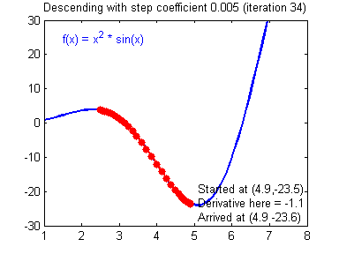
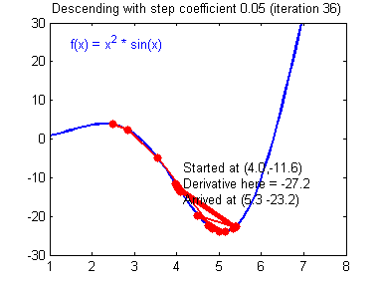


Calculation of gradient, as well as the gradient ascent
The optimal values for the weight parameters can be found, when the gradient becomes equal to 0. At this point the likelihood of the data becomes maximal. When enough time and sufficiently small learning rate are given, the gradient ascent on a concave function will always reach the global optimum. The learning rate must be chosen in such way, that it is not too small, which will slow down the calculation, or too high, leading to diverging of the gradient ascent algorithm and wrong results.
A gradient descent algorithm with a good learning rate (converging) and a bad learning rate (diverging). In this case it is gradient descent, because the cost of loss function is calculated, which must me minimal. (Images: Adam Harley)
Gradients:
$$dz=y_{i}−ỹ_{i}$$
$$dω=x_{i}^{T}dz$$
cost function J(w,b)
Gradient ascent:
$$ω=ω+αdω$$
weight variable [ω]
weight variable [ω]

Slide 6
Implementing the task in Python 3

Slide 7
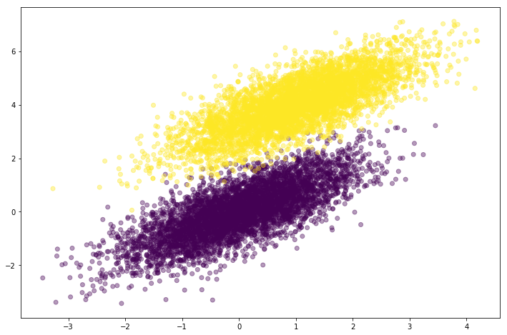
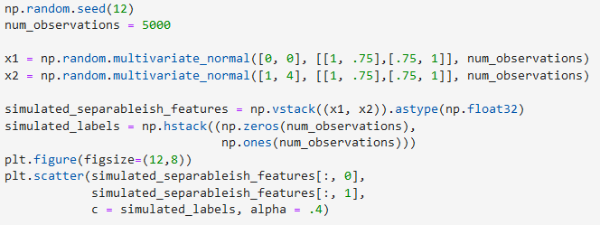
Generating the input data
The initial input data was be generated. The random number generator of Python 3 was used for this purpose.
two samples of random data, with the same deviation, but different mean, the first labelled as 0, the second labelled
as 1. The Python function (multivariative_normal) was used to generate random numbers with normal (Gaussian)
distribution.

Slide 8

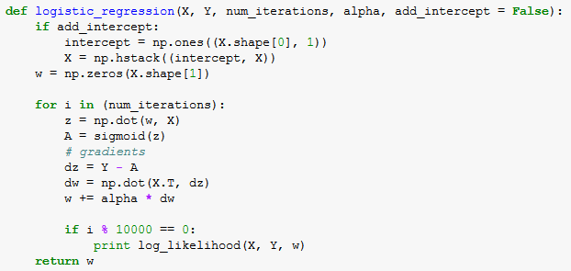

Defining functions for the logistic regression algorithm
Implementing the logistic regression as function in Python
Defining the sigmoid function: Defining the function of the logistic regression:
Defining the log-likelihood function:
It is important to vectorize the variables by the means of the
NumPy functions np.dot(), np.sum(), np.prod() etc.,
as compared with using “for loop”, because loops slow down
the code. In addition, it is recommended to initialize the weight
variables using the random number generator, when implementing
logistic regression in neural networks, as compared with the
initialization with zeros because the functions in the nodes
will become symmetric and will calculate the same function

Slide 9
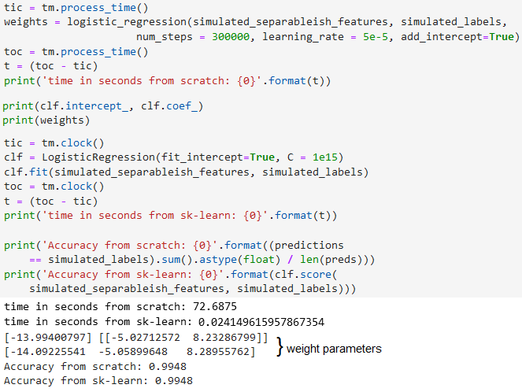
Comparing our written function “from scratch” with the function from the sk-learn library
The performance of both functions can be
compared. The accuracy is the same, as well
as the weight parameters, used in calculation.
The time for calculation, however, is clearly
much lower for the sk-learn function (about
300 times lower)

Slide 10

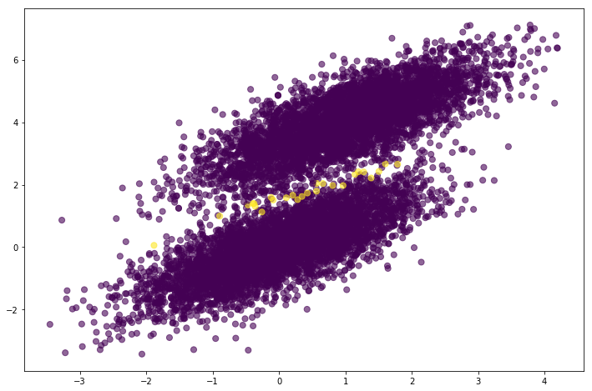
Graphical representation of the results
Graph, showing the two samples
of data, both in blue, whereas the
yellow dots show the data, that was
not predicted by the means of the
function

Slide 11
Thank you for your attention!

